Slide 1
Trench Warfare and Weapons

Slide 2
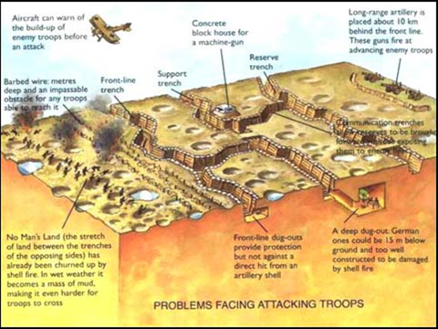

Slide 3
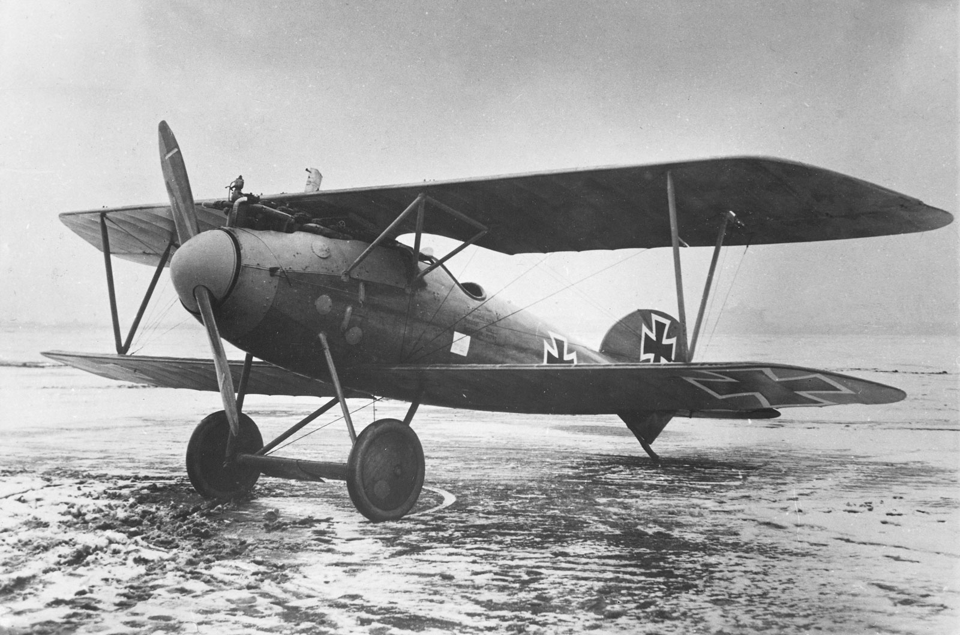
Airplanes
In the early years of the war, the biplane was used primarily for reconnaissance. The plane would hover over enemy lines and act as an artillery spotter. It also reported on troop movement.
the altitudes for observation were low enough that the planes were exposed to rifle and machine gun ground fire.
Airplanes become an offensive weapon after the machine gun is added to the Nose

Slide 4
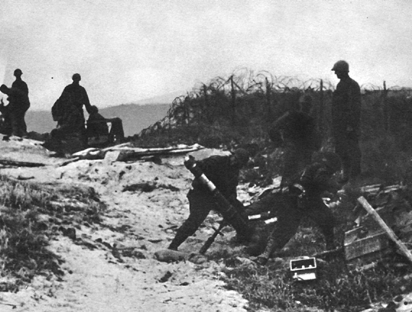
Artillery & Mortars
Large Artillery Guns were used to fire explosives into enemy trenches from up to 80 miles away
The chief advantage of the mortar was that it could be fired from the (relative) safety of the trench
it was notably lighter and more mobile than other, larger artillery pieces.
Artillery and Mortars were effective in causing unrest in enemy trenches and immobilizing tanks later in the war.
Mortar attacks were usually a warning sign of an upcoming enemy invasion

Slide 5
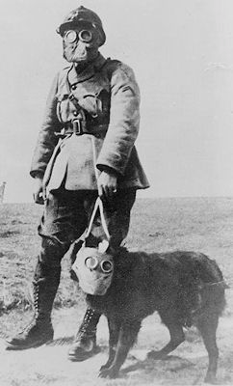
Chemical Weapons
Chlorine, Phosgene, and Mustard Gas caused violent choking attacks and temporary blindness.
The overall number of casualties quickly diminished. Indeed, deaths from gas after about May 1915 were relatively rare.
Why?

Slide 6
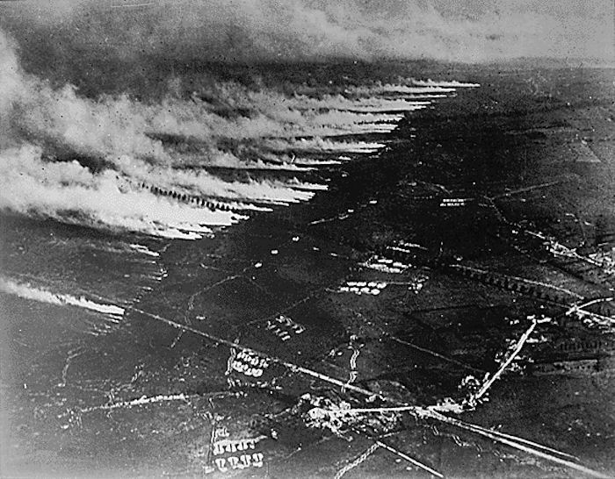

Slide 7
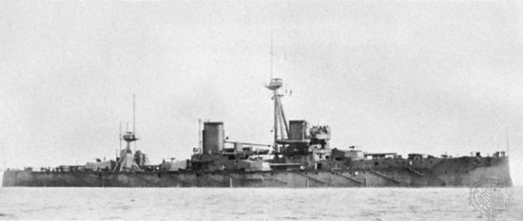
Dreadnought
The Dreadnought was 526 feet long, and carried a crew of about 800.
powered by steam turbines, gave it an unprecedented top speed of 21 knots.
It mounted a single-calibre main armament of 10 12-inch guns in five twin turrets. In addition, 24 3-inch quick-firing guns, 5 Maxim machine guns, and 4 torpedo tubes were added
Faster, more maneuverable boats routinely evaded capture and engagement.
The Dreadnought’s only notable engagement of the war was the ramming and sinking of a German U-Boat

Slide 9
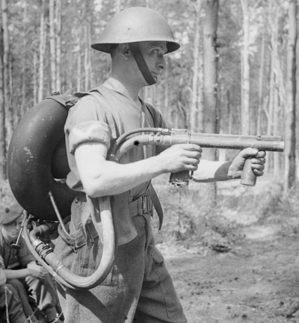
Flame Thrower
2 Types: Smaller Lighter version used by one person, back pack style shot flames 18 meters
Big version was mounted on vehicles and shot flames twice as far and up to 40 seconds long.
By the close of the war flamethrower use had been extended to use on tanks
Inconsistent: Tanks would randomly blow up, and the enemy would aim for the fuel tanks.

Slide 10
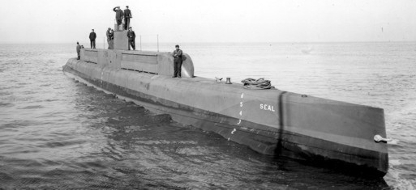
Submarines
Control the sea lanes and starve the population dependent on food supplied by other countries---neutral or otherwise
German subs had sunk over twelve million tons of enemy and neutral shipping.
Their part in blockades and unrestricted submarine warfare proved so devastating that The Versailles Treaty in 1919 specifically forbade the Germans from building submarines.

Slide 11
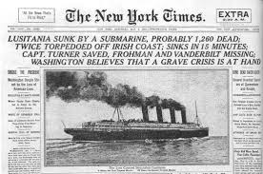
Lusitania
In early May 1915, RMS Lusitania left New York Harbor bound for Liverpool. The passengers had received a warning from the German embassy that the ship was considered an enemy carrying contraband to England, and would be a target in a zone set up by the Germans. On May 7, the boat was torpedoed 11 miles off the Irish coast (in the German prohibited zone). It was sunk by U-Boat 20 (second from left below) with heavy loss of civilian life including 126 Americans. The tragedy was a source of anger and regret in the minds of the American public when they supported U.S. direct involvement in 1917.

Slide 12
Was the sinking of the Lusitania a good reason for the United States to get involved in WWI?

Slide 13
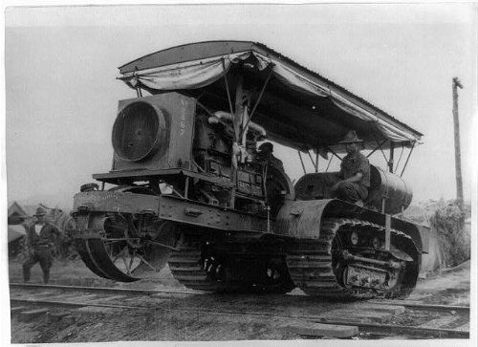
Tanks…..You’re Welcome
This British invention used American-designed caterpillar tracks to move the armored vehicle equipped with machine guns and sometimes light cannon.
Tanks worked effectively on firm, dry ground, in spite of their slow speed, mechanical problems, and vulnerability to artillery.
Tanks were Able to crush barbed wire and cross trenches, tanks were able to move forward through machine gun fire.

Slide 15
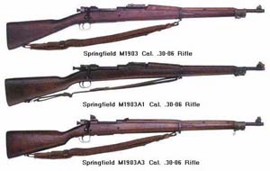
Rifles
The Number One Infantry Weapon
Easy to carry
Rifles were for Infantry and pistols were for officers
a greater impact was dependent upon the training and skill of the rifle operator himself.
Highly Trained Riflemen: 30 Rounds/min

Slide 16
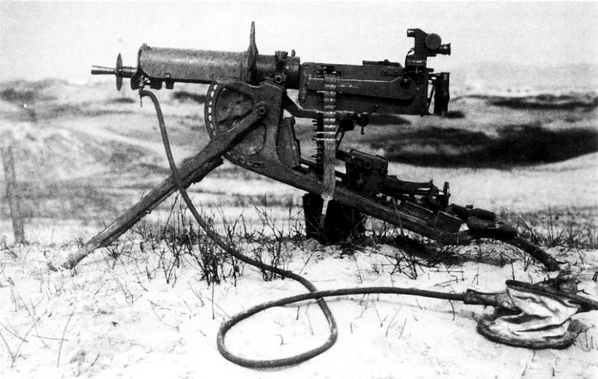
Machine Guns
The machine gun, was a fairly primitive device when general war began in August 1914.
Machine guns were heavy and bulky weighing over 130 pounds with the ammunition
Gun was mounted on a tripod and manned by a crew of 4-6
The early machine guns had their share of problems
Over Heating

Slide 17
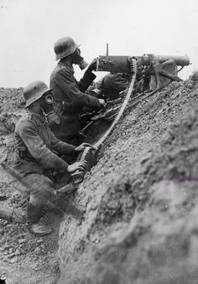
Machine Guns
Was a great defensive weapon.
Machine Guns were strategically placed so their fire was over lapping.
Machine guns could fire over 500 rounds per minute
A Regiment of trained riflemen could fire around 30
1 Machine Gun was the equivalent of 80 riflemen

