Slide 1
The Cold War

Slide 2
ESSESNTIAL QUESTIONS
What is the difference between Communism and Capitalism?
How do different political and economic values create conflict during The Cold War. Give examples.
How did the US and the Soviet Union go from Allies in WWII to Enemies?

Slide 3


DEMOCRACY VS. COMMUNISM
A system of government in which there is no private property and there are no economic classes
A form of government in which the supreme authority rests with the people

Slide 4
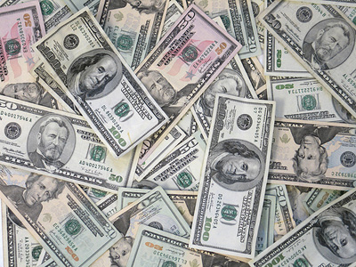
What is capitalism?
Economic system.
Believes in individual ownership and competition.
The theory is that when everyone is selfish, it benefits everyone.
Adam Smith is “the” capitalist.

Slide 5

What’s good about capitalism?
Freedom, choice.
You can work wherever, buy whatever, and pretty much do whatever.
If you’re successful, you can be very successful. Think Bill Gates.

Slide 6
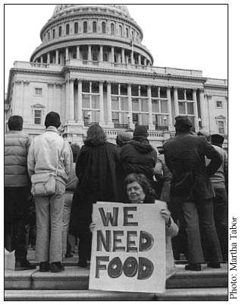
What’s bad about capitalism?
No “safety net.”
If you’re unsuccessful, you can be very unsuccessful. Think about the poor.
Big gap between rich and poor.

Slide 7
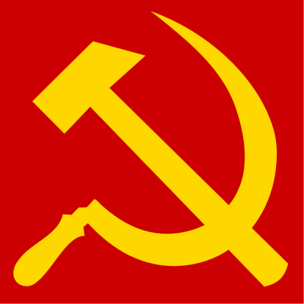
What is communism?
Economic system.
Believes in collective (group) ownership and a planned economy.
The theory is that everybody pools their resources and labor to evenly distribute everything.
Karl Marx is “the” communist.

Slide 8
Marxism
Marx and Engels studied the history of the world’s economies
Socialism
Communism!!!!
Capitalism
They believed they discovered an inevitable pattern
Feudalism
Basic Communism

Slide 9
Communism/Socialism:
What’s the difference?
  Socialism is the stage between Capitalism and Communism.
  It builds upon the previous system (Capitalism) by nationalizing the “means of production” (i.e. corporations, resources, banks, etc.), but not by making everyone equal.
  People are paid wages based on several factors (social need, difficulty, amount of schooling required, etc.), so not everyone will make the same wage.

Slide 10
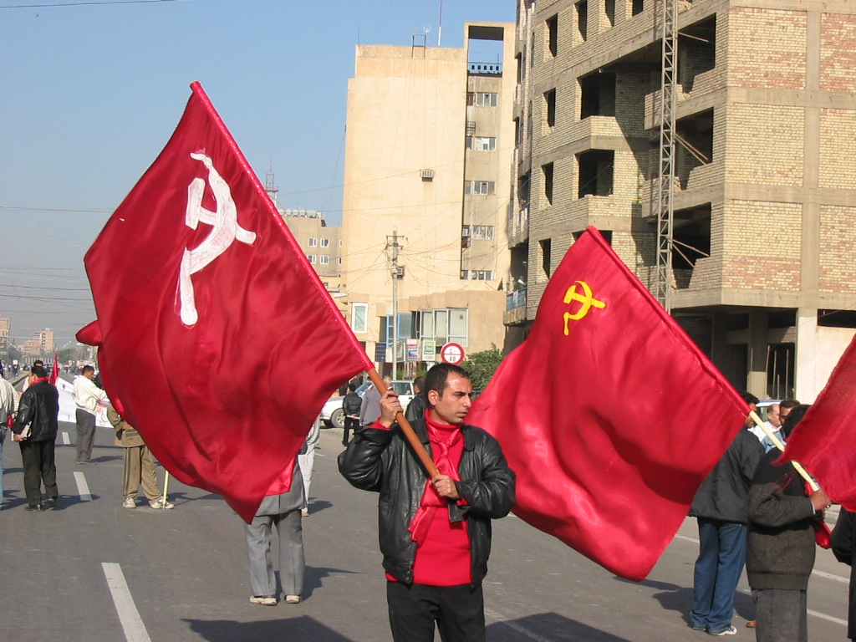
What’s good about communism?
Security, basic needs met.
Everyone would have a job, house, health care, etc.

Slide 11
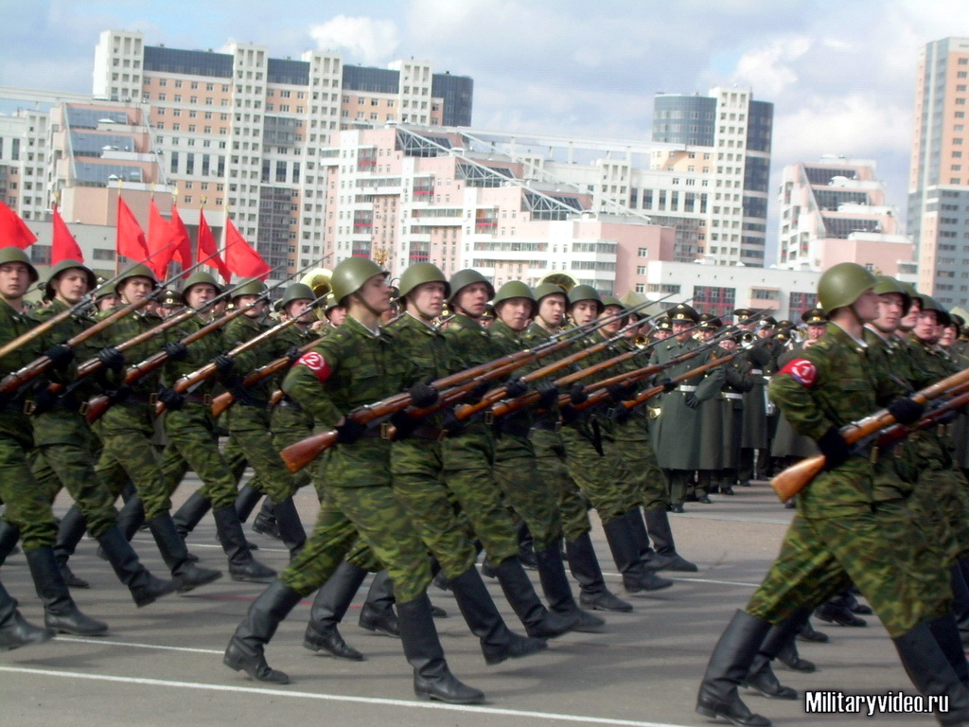
What’s bad about communism?
Lack of choice
No reward for being a better worker or punishment for being a slacker.
Everyone expected to be the same.
Typically totalitarian

Slide 12
TOTALITARIAN
A form of government in which the person or party in charge has absolute control over all aspects of life
No freedom of press or speech
Notes:
USSR

Slide 13
How does this relate to the Cold War?

Slide 14
How did the US and the Soviet Union move from allies to enemies?
Uneasy alliance
  Different economic and political systems
Development of atomic bomb
  Stalin resents U.S. hid atomic bomb
COLD WAR: conflict between nations carried on by political and economic means rather than direct conflict
Notes:
-- US emerged as a superpower after WWII because we were the strongest military; we didn’t have fighting at home; we had atomic weapons
-- US and Soviet still had different political views

Slide 15
Former Allies Clash
The Potsdam Conference
  July 1945 conference with U.S., Great Britain, and Soviet Union
Stalin does not allow free, multiparty elections in Poland
  Bans democratic parties
Soviets want reparations from Germany; Truman objects
U.S. emerges from war as great economic power
  Wants Eastern European raw materials, markets

Slide 16
TENSIONS MOUNT
Soviet Union also has great economic and military strength
Unlike U.S., Soviet Union suffered heavy devastation on own soil
Installs communist rule in satellite nations (countries it dominates)
1946 Stalin announces that war between communism and capitalism inevitable

Slide 17
CONTAINMENT
U.S. establishes policy of containment (measures to prevent spread of communism)
Truman Doctrine- “it must be the policy of the United States to support free peoples who are resisting attempted subjugation by armed minorities or by outside pressures”
  - provided economic and military aid to nations threatened by internal or external opponents
Marshall Plan- provided $13 billion in economic aid to European countries after WWII- caused communism to lose appeal

Slide 18
THE IRON CURTAIN
Coined by Winston Churchill
March 1946
Described Soviet control over Eastern European countries
Stalin used Churchill’s words to persuade his people that the US and Great Britain were enemies of the Soviet Union
Notes:
At the Yalta and Postdam Conferences, American and British leaders pressed Stalin (USSR) to hold free elections in Soviet occupied lands
Stalin had no intention of giving up political and economic control over Eastern Europe; Stalin felt he was fully justified in wanting control over Eastern Europe
-- to achieve this goal, Stalin used whatever means necessary -- he outlawed political parties and newspapers that opposed Communist parties; the Soviets also jailed or killed some political opponents and sometimes even rigged elections to ensure the success of Communist candidates
--this is how the Soviets managed to install Communist governments throughout Eastern Europe
-- American and British leaders didn’t like seeing Eastern Europeans fall under the leadership of a dictator, especially after they had suffered during WWII
-former British prime minister traveled to the US and made a speech in March in Fulton, Missouri – he attacked the Soviet Union for creating what he called an “iron curtain” – what he meant by this was his belief that communism had created a sharp division in Europe
-- Stalin’s reaction to Churchill’s speech was harsh, he used Churchill’s words to persuade his people that the US and Great Britain were enemies of the Soviet Union
-- this became the excuse to rebuild the Soviet Union’s military strength – this slowed the pace of rebuilding the shattered Soviet countryside

Slide 19
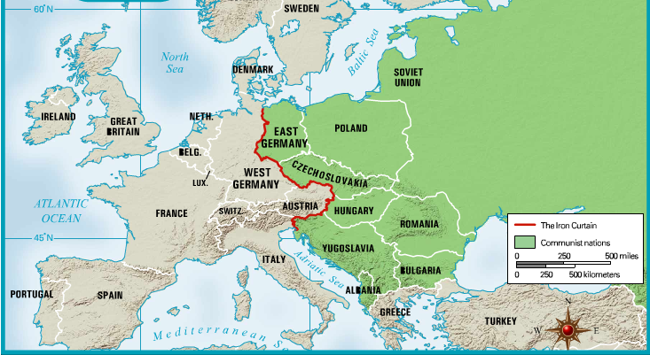
The Iron Curtain

Slide 20
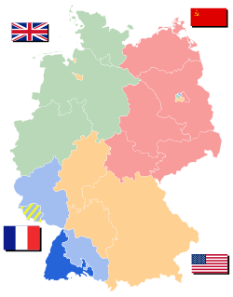
Superpowers Struggle over Germany
Germany was divided in two, the East controlled by communist Soviets and the West controlled by democratic Allies
To gain control Stalin closes highways and rail routes into West Berlin
US and Britain begin Berlin
airlift to provide West Berlin with
necessary supplies and food
Stalin then lifts blockade; Federal
Republic of Germany, and
German Democratic Republic form

Slide 21
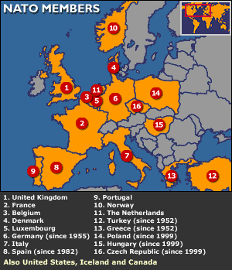
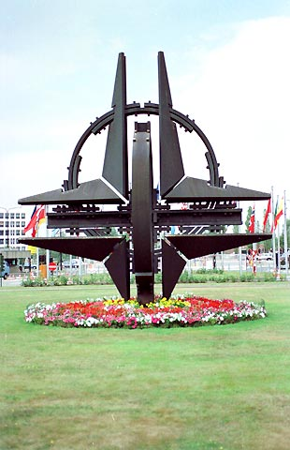
The NATO Alliance
Berlin Blockade increases
West’s fear of Soviet aggression
Belgium, Denmark, France, Great Britain, Iceland, Italy, Luxembourg, Norway, the Netherlands, and Portugal joined US and Canada on April 4, 1949 to form North Atlantic Treaty Organization
      A defensive military alliance
      First time America entered an alliance during peacetime

