Slide 1
Inventions of the Reniassance

Slide 2
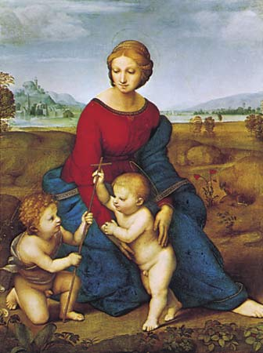
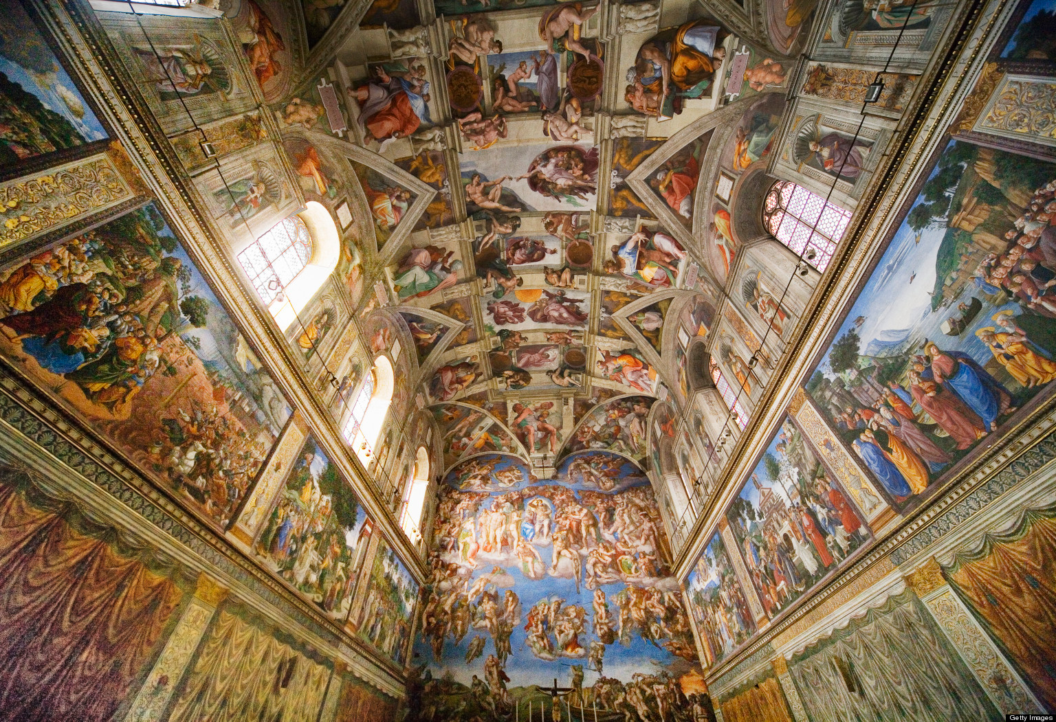
The works of Da Vinci, Michelangelo and Raphael inspired the renaissance way of thinking for people north of Italy. Especially in places like England, France, and Germany.

Slide 3
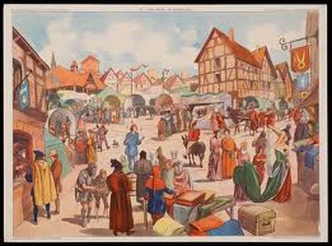
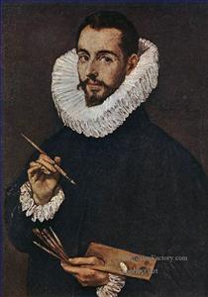
In the early 1450’s the population was beginning to recover from the plague, and the end of the 100 years’ war which both had negative impacts on the population. The Population was increasing and business was good for merchants who began to sponsor artists with their new found wealth

Slide 4
The renaissance period gives rise to not only new ways of thinking like, humanism but also many new and exciting inventions that we still use today.

Slide 5
Sketches and drawings from the notebooks of Leonardo Da Vinci show us he was ahead of his time. He had drawings and plans that resemble modern day technology. Like the aerial screw, the self-powered cart, the flying machine and many others

Slide 6
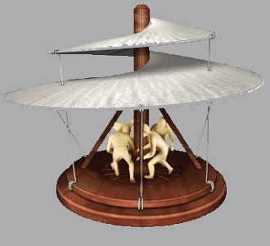
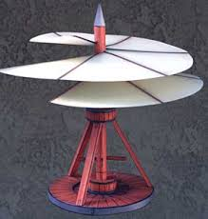
The Aerial Screw

Slide 7
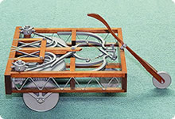
The Self Powered Cart

Slide 8
The Flying Machine

Slide 9
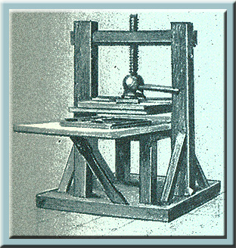
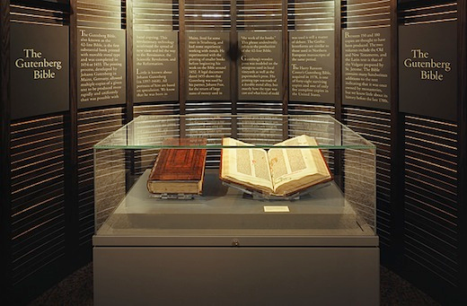
The Printing Press
The Invention of the Printing Press by Johan Gutenburg in 1440 gives the renaissance a better and faster way to spread new ideas and information. The first book printed with the printing press was the bible, or the Gutenburg bible. The printing press used movable type to be more efficient.

Slide 10
Vernacular
People became more informed and had a desire for knowledge, writers began using vernacular writing (Language that was spoken by ordinary people). This made reading much easier.

Slide 11
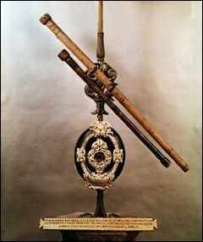
The Telescope
The invention of the telescope paved the way for Galileo to make is groundbreaking and controversial discovery in proving a theory Copernicus developed called heliocentrism. Meaning that the Sun was actually at the center of the universe not the earth. This discovery did not go over well with the Catholic Church and Galileo was exiled to Siena.

