Slide 1
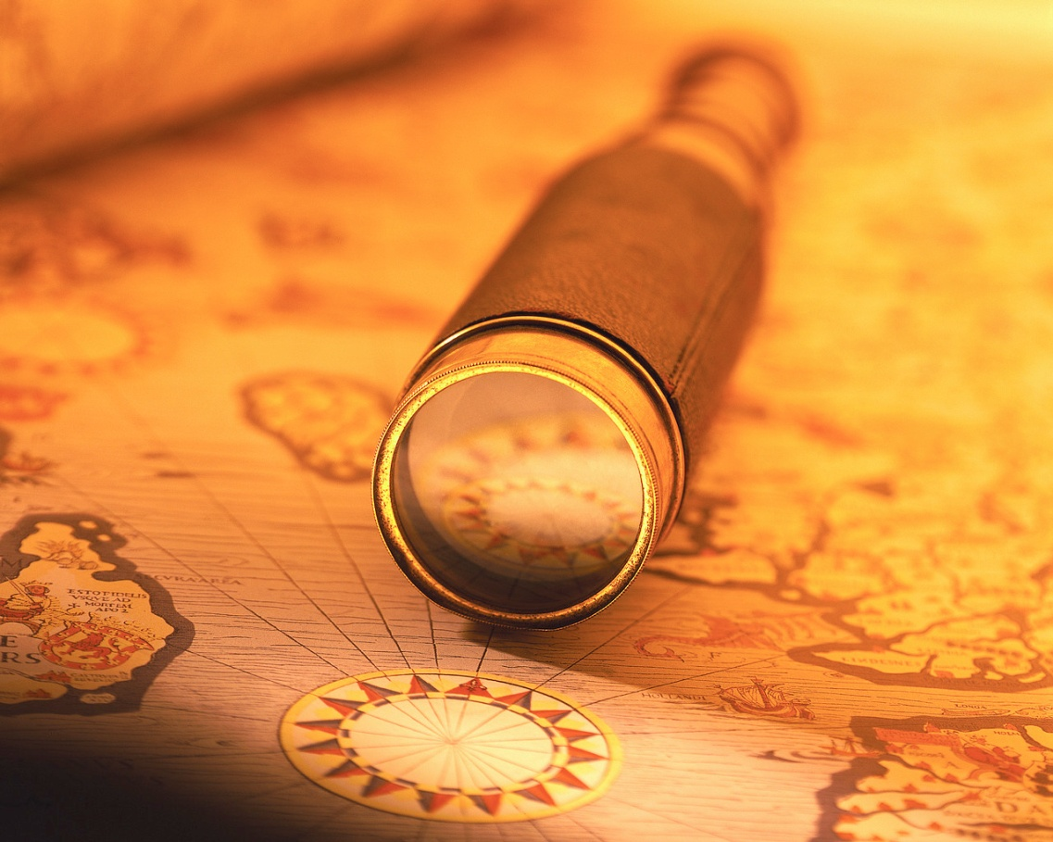
Ch. 19: The Age of Exploration

Slide 2
Europeans Explore the
East
European exploration was an important step toward the global interaction existing in the world today
Advances in sailing technology enabled Europeans to explore other parts of the world

Slide 3
Europeans Explore the East
GLORY!!
For “God, Glory, and Gold” (The 3 G’s): people wanted to grow rich and spread Christianity
  Bartolomeu Dias (Portuguese Explorer): “To serve God and his Majesty, to give light to those who were in darkness and to grow rich as all men desire to do.”

Slide 4
Europeans Explore the East
How could people expect to become wealthy? From overseas trade of items such as spices
  Europeans never had these items (nutmeg, pepper, etc.) until during the crusades. After the crusades ended, there was still a high demand
  Europeans sought their own route to trade directly with Asia

Slide 5
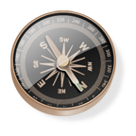
Europeans Explore the East
Technology helped to make this possible:
  Caravel: a ship that could sail against the wind (because of triangular sails—adopted from the Arabs)
  Astrolabe: perfected by Muslims, determine the latitude (how far north or south) of a ship
  Magnetic compass: Chinese invention, accurately track direction

Slide 6
Portugal
First European country to establish trading on the west coast of Africa (gold, ivory, and slaves)
Strong government support of Exploration
Explorers:
  Bartolomeu Dias: first to sail
  around the southern tip of Africa
  Vasco Da Gama: sailed further east, to the coast of India, Gave Portuguese a direct Sea Route to India

Slide 7
Spain: The first Europeans in the Americas
Columbus: wanted to find a direct sea route to Asia by sailing West
  1492: Landed in the Caribbean instead
  Named the natives “los indios” or “indians”
  Made several voyages after his first one
  Hernando Cortes: landed on the shores of Mexico, looking to conquer lands for Spain.
      --“Conquistadors”=“conquerors”
      --Conquered the Aztecs

Slide 8
Spain: The first Europeans in the Americas
Francisco Pizarro: (1532) conquered the Incan Empire in Peru
Priests accompanied conquistadors in order to convert the native people

Slide 9
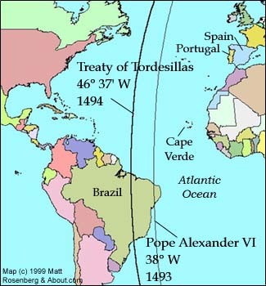
The Treaty of Tordesillas
Spain and Portugal were rivals
  Pope Alexander VI wanted to help avoid tension
    Imaginary dividing line, drawn north to south
    All land to the west would be Spain’s
    All land to the east would be Portugal’s
    Line moved further west before agreement was signed in 1494

Slide 10
Who else got involved?
French
Dutch: East India Trading Company dominated trade in East India and the Indian Ocean
  Capital, Amsterdam, became leading commercial center
British: English East India Company, successful in trading Indian cloth

Slide 11
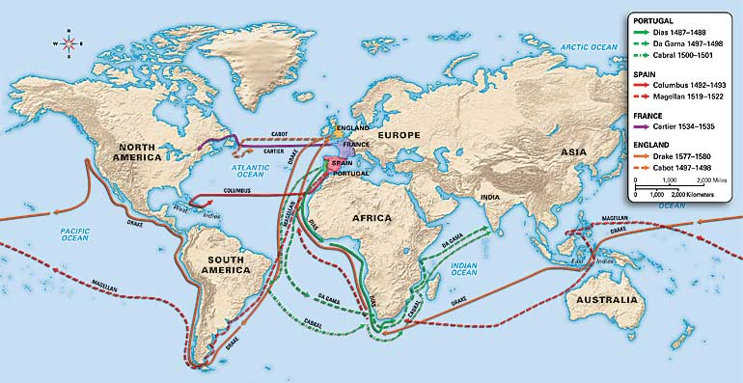

Slide 12
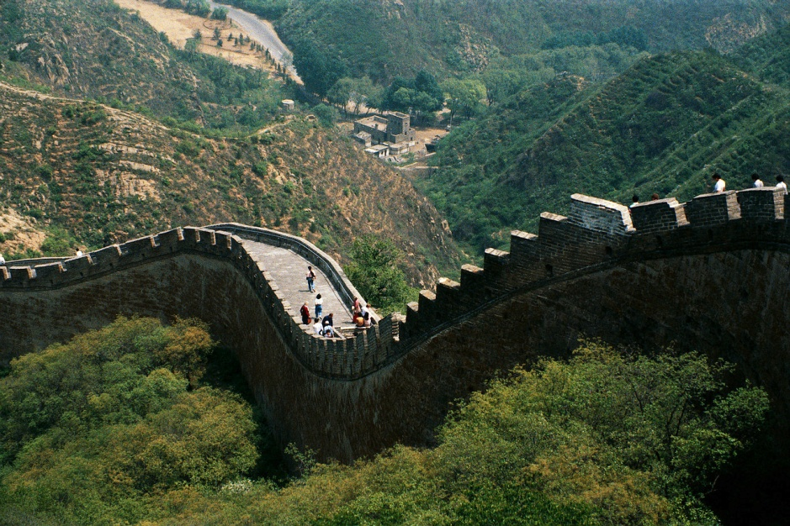
China Limits European Contacts
China’s independence from the West continues today
Advances in the Ming and Qing dynasties left China uninterested in European contact

Slide 13
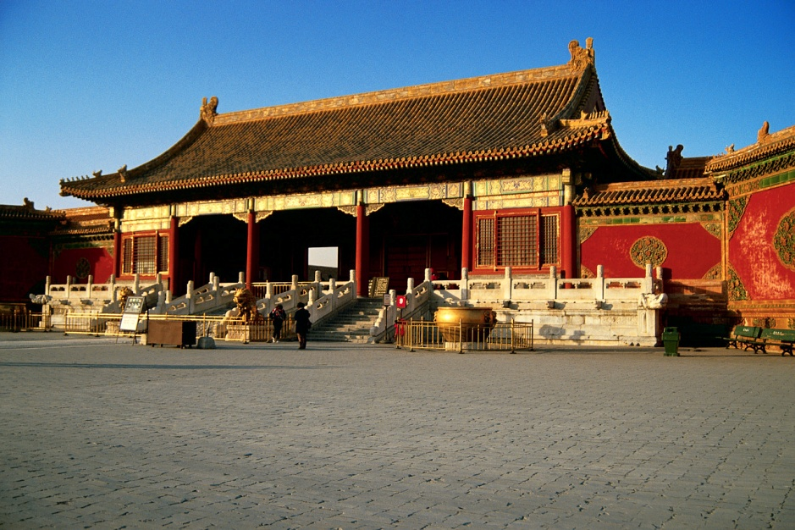
China: the Ming Dynasty
(1368-1644)
China became the dominant power in Asia under the Ming
Hongwu: first emperor
  His son, Yonglo, sent voyages of exploration before Europeans ever did (1405)
    Also built the forbidden city
Notes:
When Yonglo moved the capital to Beijing, he built a new palace--the forbidden city, so called because commoners and foreigners were not allowed to enter.

Slide 14

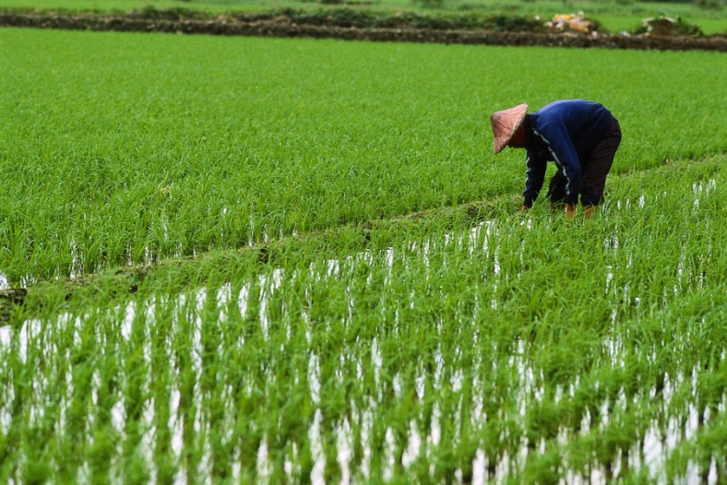
China: the Ming Dynasty
(1368-1644)
Zheng He (jung huh) went on seven voyages of exploration
Only the government traded with foreigners
  Some people smuggled items
Never became industrialized because:
  Idea of commerce offended Confucian beliefs
  Tradition favored agriculture

Slide 15
China: the Qing Dynasty
1644: the people of Manchuria (manchus) invaded China and the Ming dynasty collapsed.
Expanded China’s borders
Upheld traditional Chinese beliefs and social structures
Under Qian-long (chyahn-lung), China reached its greatest size and prosperity
Continued isolation in trade but became partners with the Dutch
  Began the trade of TEA to Europe!
Notes:
Although the invaders were Manchus, they chose a Chinese name, the Qing

Slide 16

Life in Ming and Qing China
Qing: increase of irrigation and fertilization; new crops such as corn and sweet potatoes, brought by Europeans
Women: not valued, many female infants killed, although many responsibilities at home
Traditions preserved through
isolation
Notes:
Technique valued in painting and pottery

Slide 17
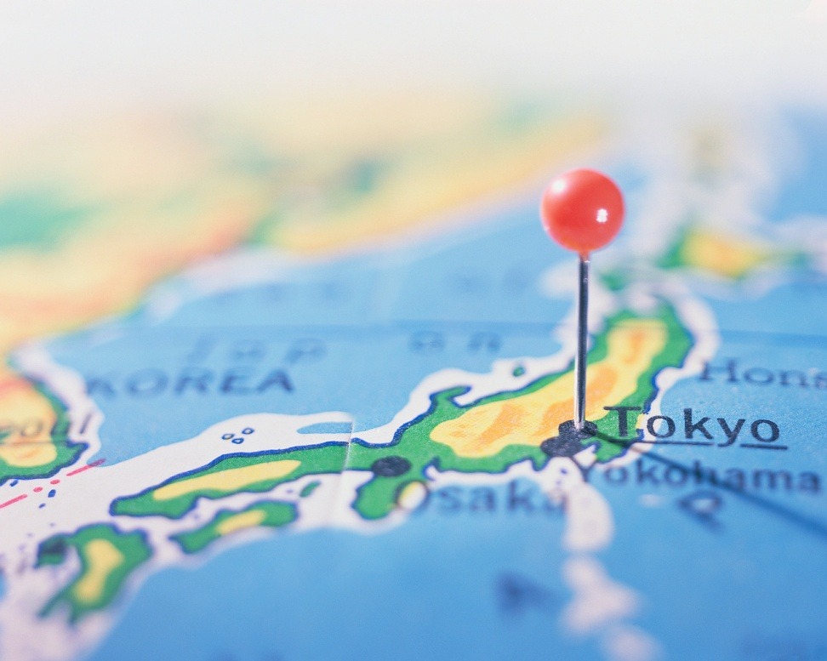
Japan Returns to Isolation
The Tokugawa regime unified Japan and began 250 years of isolation, autocracy, and economic growth
Japan continues to limit and control dealings with foreigners

Slide 18
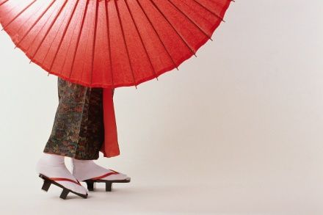
Japan
Tokugawa Ieyasu unified Japan
Structured society, influenced by Confucius
  Emperor
  Shogun: military leader, actual ruler
  Daimyo: powerful landholding Samurai
  Samurai Warriors
  Peasants and Artisans
  Merchants

Slide 19
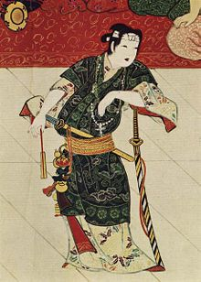
Culture in Japan
One lone wailing voice
in the lovely cold forest:
black timberwolf song
-haiku written by Zino Press author
Matt Cibula, who was the Head-to-Head
Haiku Slam National Champion in 1995-1996.
The rise of large commercial centers provided employment for women
Haiku: 5-7-5 syllable, 3 verse poetry
  Presents images
Kabuki theater: actors in costumes using music, dance, and mime to perform skits about modern life

Slide 20
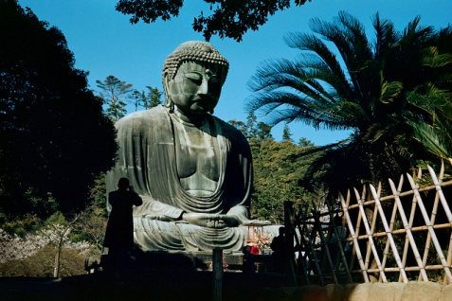
Contact between Europe and Japan
Portugal (1543)- brought clocks, eyeglasses, tobacco, firearms
  Firearms were an important change in the life of the Samurai
  Missionaries came to convert; created conflicts between Christianity and Japanese traditional values
  Japanese wanted trade but not Europeans’ ideas and ways
Notes:
Many samurai met their end fighting enemies with guns while they still used swords

Slide 21
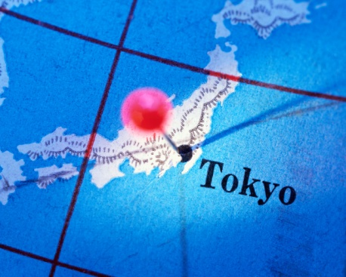
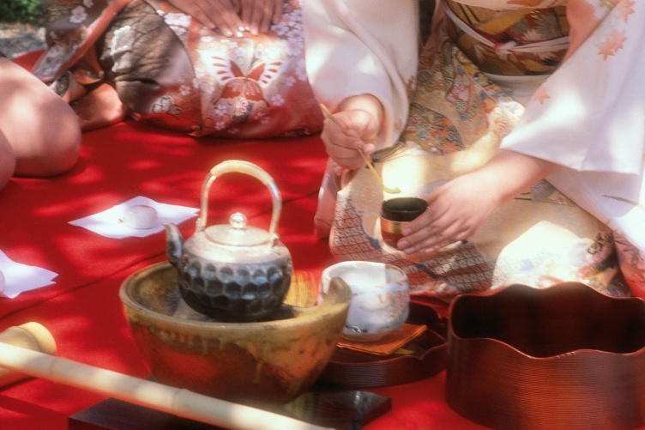
Japan: Closed Country
Most commercial contacts with Europeans ended
  Dutch and Chinese allowed to trade through port in Nagasaki
  English voluntarily left, Portuguese and Spanish expelled

